Slide 1

Fighting Lung Cancer
Miguel Simón
December 2020

Slide 2
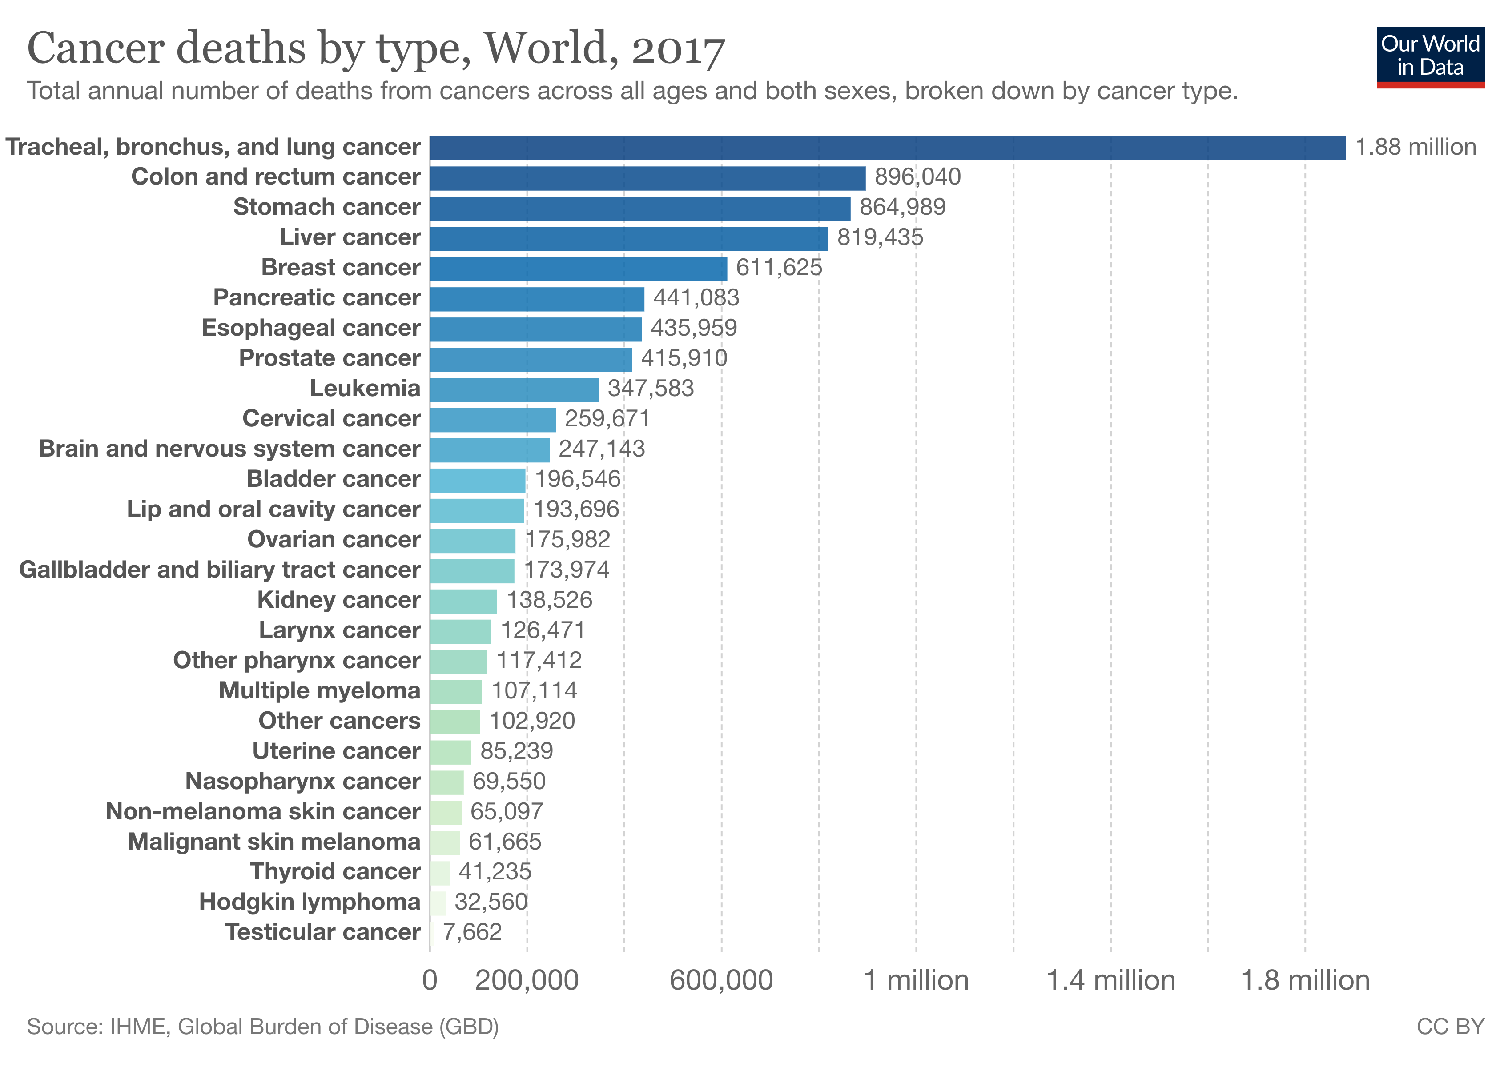
Scientific Research in Lung Cancer

Slide 3

Scientific Research in Lung Cancer

Slide 4
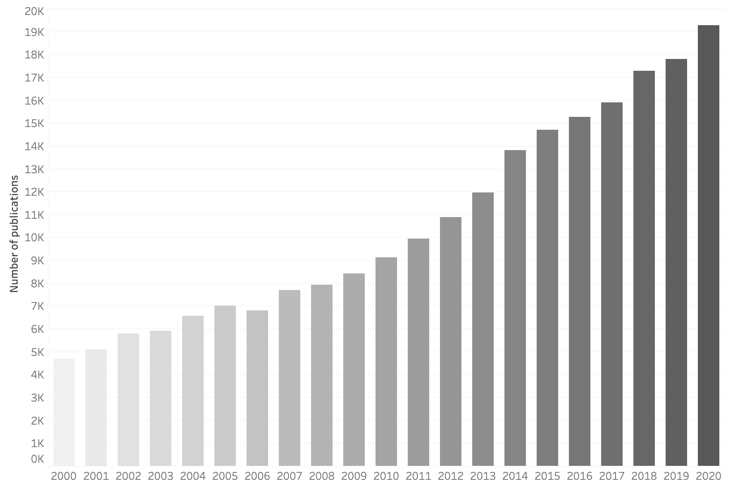
Scientific Research in Lung Cancer
Number of Publications

Slide 5
Scientific Research in Lung Cancer
Number of Publications
~400000 publications

Slide 6
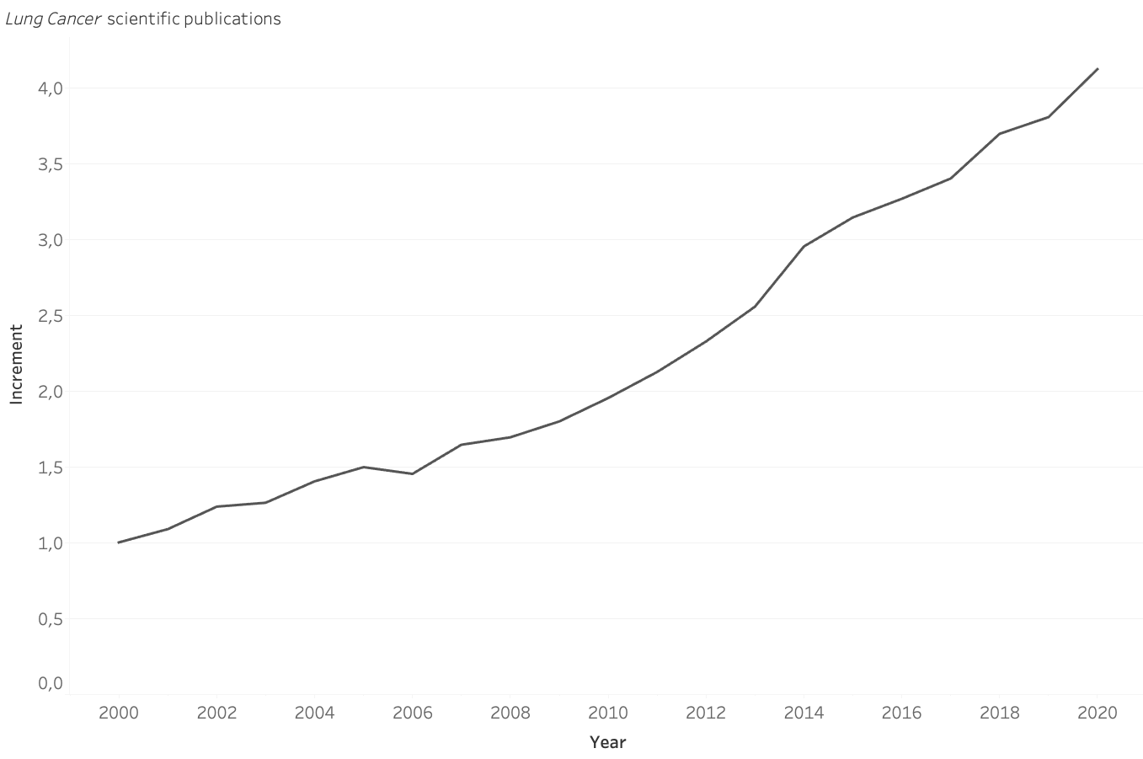
Scientific Research in Lung Cancer
Num Publications

Slide 7
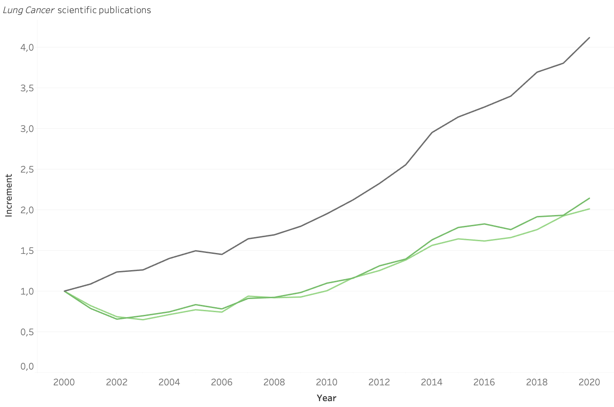
Scientific Research in Lung Cancer
Num Publications
Treatment
Diagnosis

Slide 8
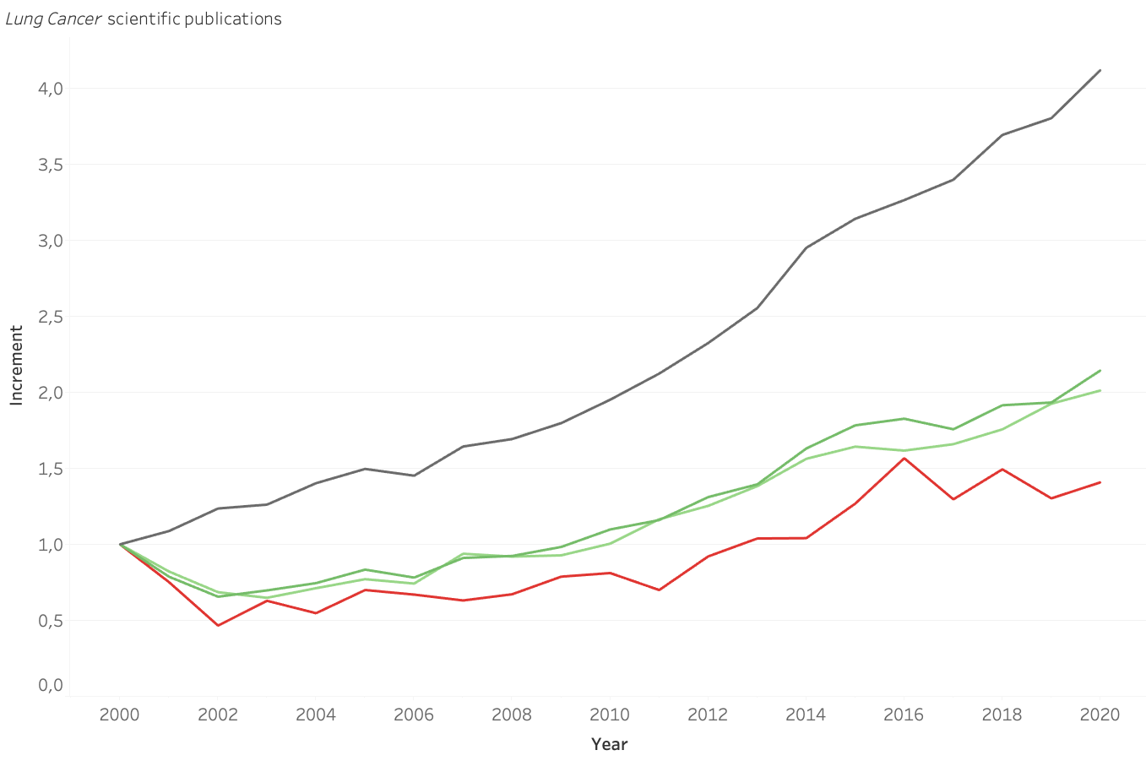
Scientific Research in Lung Cancer
Num Publications
Treatment
Diagnosis
Pollution

Slide 9
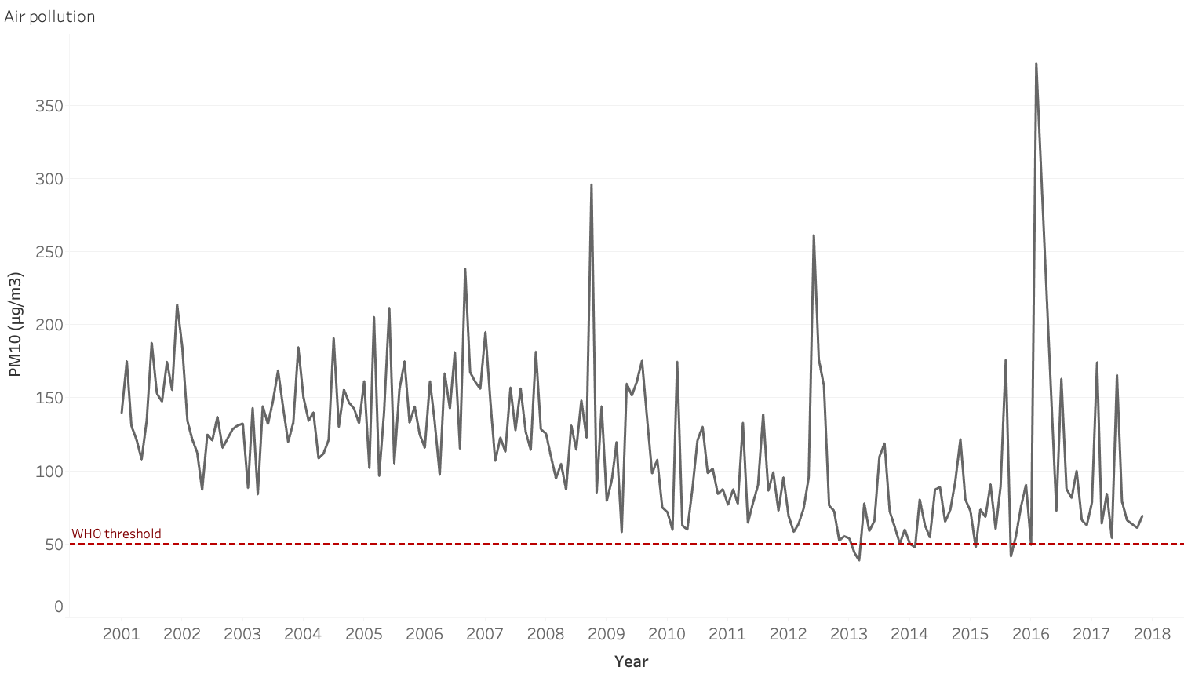
Scientific Research in Lung Cancer

Slide 10
Model I (Questionnaire)
1000 patients
Low, Medium, High
24 features:
Gender
Air pollution
Dust Allergy
Genetic Risk
Fatigue
Snoring
Alcohol Use
Chest pain
Obesity
...

Slide 11
Model I (Questionnaire)
1000 patients
Low, Medium, High
24 features:
Gender
Air pollution
Dust Allergy
Genetic Risk
Fatigue
Snoring
Alcohol Use
Chest pain
Obesity
...
Simplified Model
Low, Medium, High
4 Short questions:
Height
Weight
Smoker
Alcohol use

Slide 12
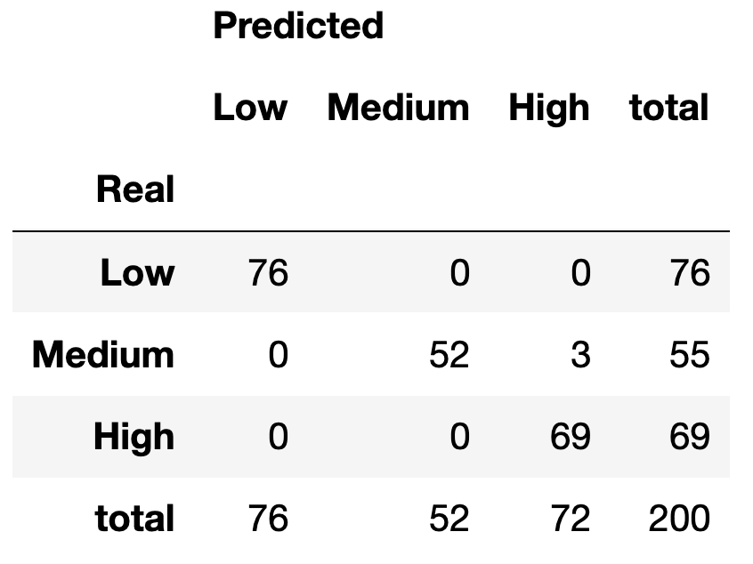
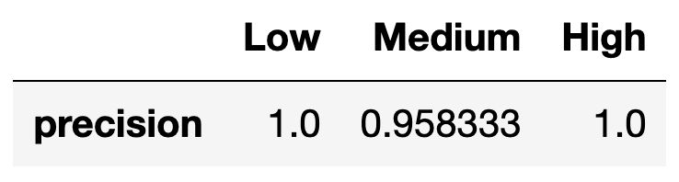
Model I (Questionnaire)
1000 patients
Low, Medium, High
24 features:
Gender
Air pollution
Dust Allergy
Genetic Risk
Fatigue
Snoring
Alcohol Use
Chest pain
Obesity
...
Test Set Results
Simplified Model
Low, Medium, High
4 Short questions:
Height
Weight
Smoker
Alcohol use

Slide 13
Transcriptomics

Slide 14
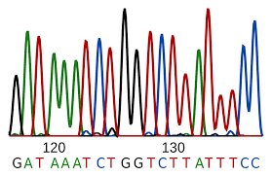
Transcriptomics
Sequencing

Slide 15
Transcriptomics
+
=
Transcriptomics
Sequencing

Slide 16
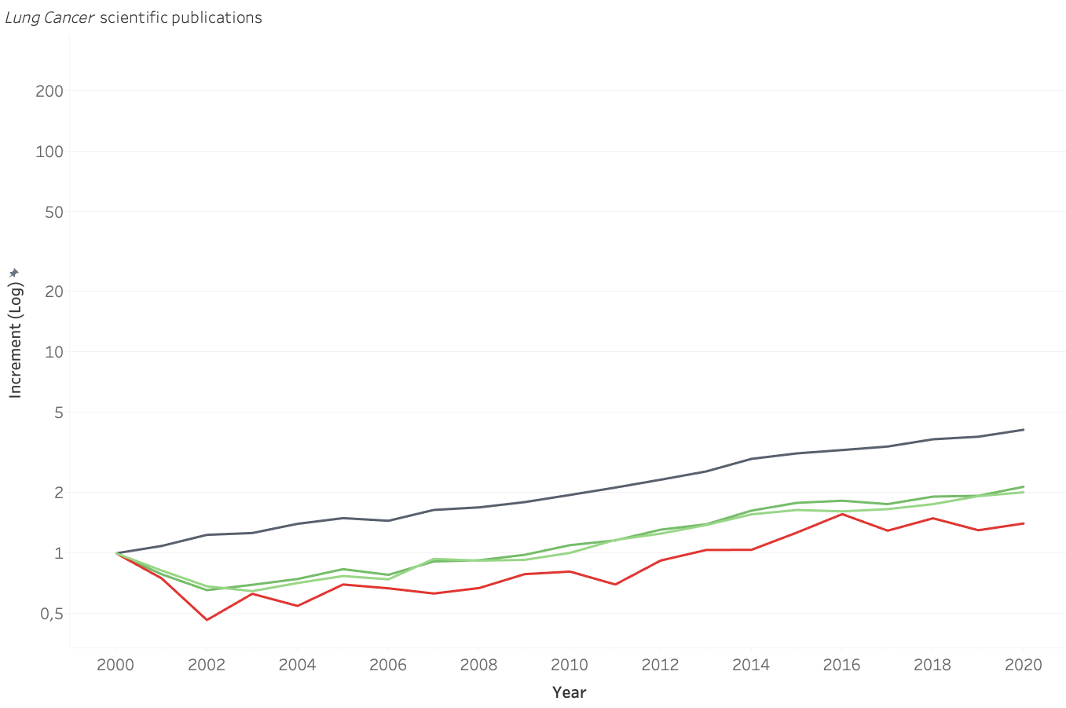
Scientific Research in Lung Cancer
Num Publications
Treatment
Diagnosis
Pollution

Slide 17
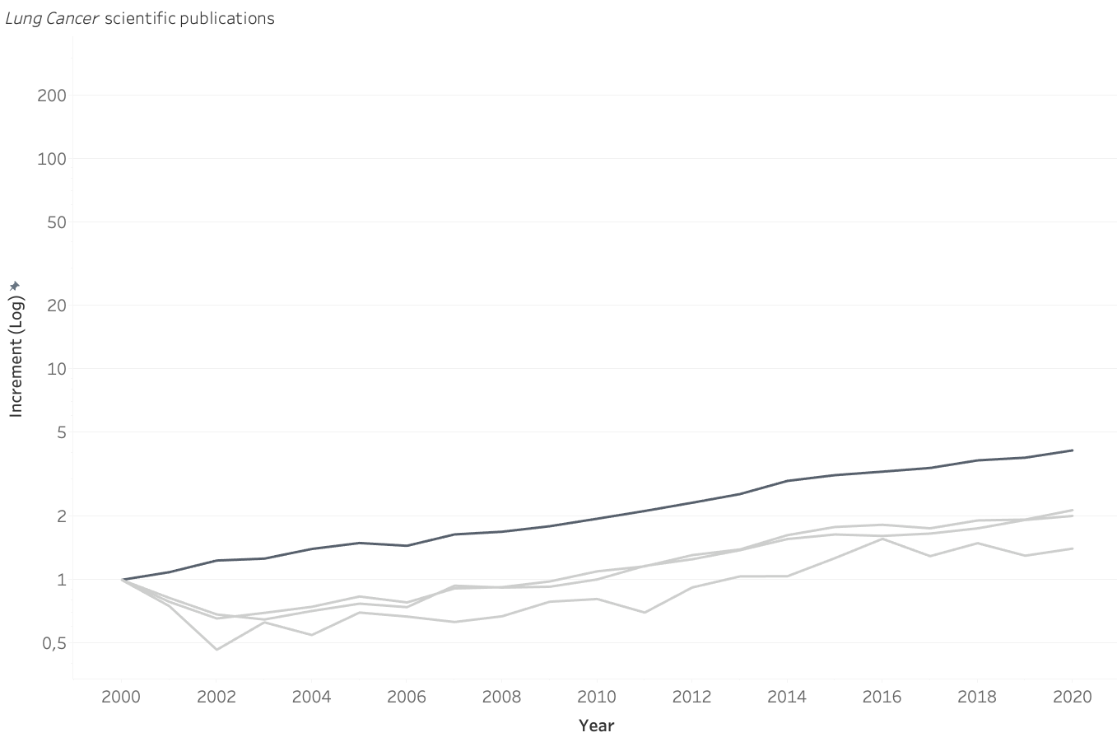
Scientific Research in Lung Cancer
Num Publications
Treatment
Diagnosis
Pollution

Slide 18
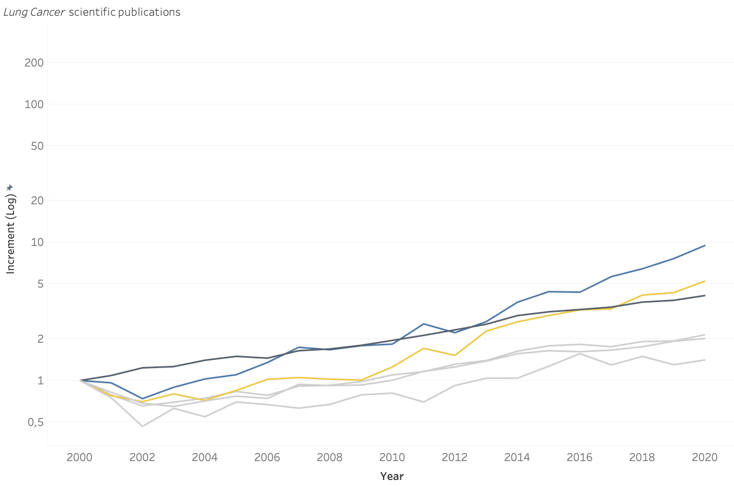
Scientific Research in Lung Cancer
RNA
Sequencing
Num Publications
Treatment
Diagnosis
Pollution

Slide 19
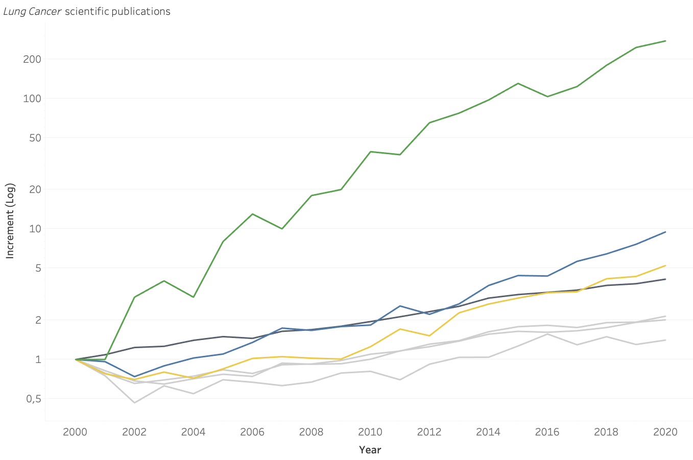
Scientific Research in Lung Cancer
Transcriptomics
RNA
Sequencing
Num Publications
Treatment
Diagnosis
Pollution

Slide 20
Model II (Test)
1200 patients
Cancer / No Cancer
Transcriptomic Data
(20000 genes/features)

Slide 21
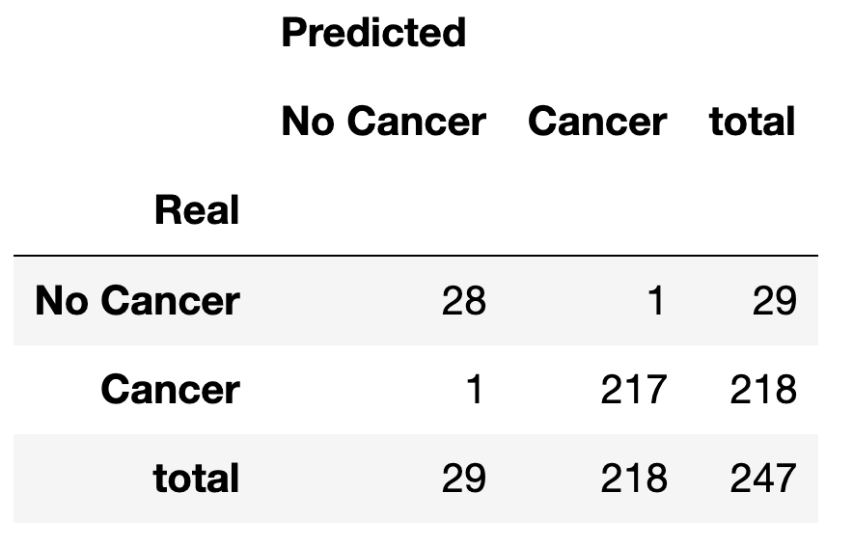
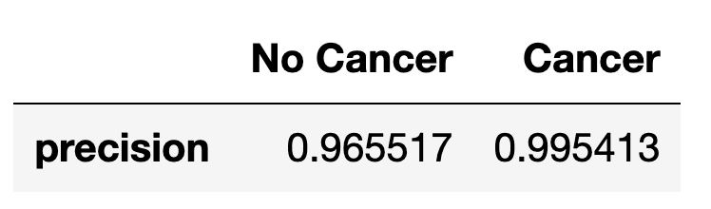
Model II (Test)
Test Set Results
1200 patients
Cancer / No Cancer
Transcriptomic Data
(20000 genes/features)

Slide 22
Full Protocol
People living in cities

Slide 23
Full Protocol
People living in cities
Model I
(Questionnaire)

Slide 24
Full Protocol
High Risk
People living in cities
Medium Risk
Low Risk
Model I
(Questionnaire)

Slide 25
Full Protocol
High Risk
People living in cities
Medium Risk
Low Risk
Model I
(Questionnaire)

Slide 26
Full Protocol
High Risk
Model II
(Test)
People living in cities
Medium Risk
Low Risk
Model I
(Questionnaire)

Slide 27
Full Protocol
Positive
High Risk
Negative
Model II
(Test)
People living in cities
Medium Risk
Low Risk
Model I
(Questionnaire)

Slide 28
Full Protocol
Positive
High Risk
Negative
Model II
(Test)
People living in cities
Medium Risk
Low Risk
Model I
(Questionnaire)

Slide 29

Full Protocol
Positive
High Risk
Negative
Model II
(Test)
People living in cities
Medium Risk
Low Risk
Model I
(Questionnaire)

Slide 30
Fighting Lung Cancer
Miguel Simón
Thanks!

